Slide 1
Imaging Bundle

Slide 2
caBIG Bundle Distribution
Objective
  A set of interrelated domain specific tools from caBIG
Current Bundles
  Life Sciences (NCIA, caTissue, caArray …)
  CTMS (caExchange, Patient Study Calendar …)
caGrid Ready
Distribution Mechanism
  Download from Gforge
  Installation Guides

Slide 3
Imaging Bundle
NCIA
  CTP
  NCIAGridService
IVIM
XIP Builder
  XIP Host that can Q/R/S DICOM & AIM objects over the grid
  Ref Workstation that can display DICOM & AIM objects and create AIM objects
AIM
  AIMDataService

Slide 4
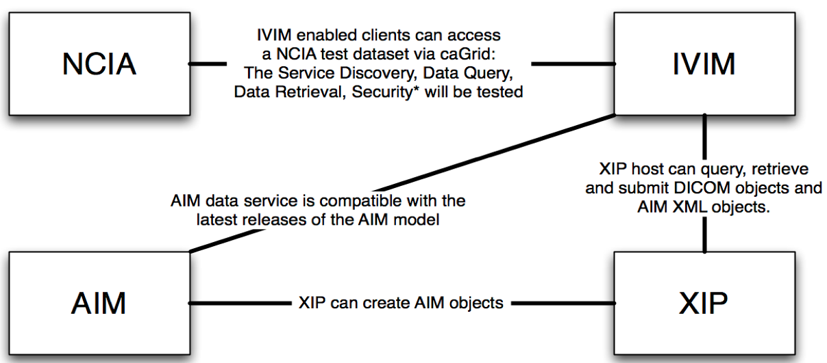
Single Interoperability Infrastructure

Slide 5
Distribution Mechanism
Source Download & Install
Virtual Machines
  (Xen, VMWare)
Reference Implementations
Documentation

